Slide 1
The Leading Causes of death in the United States in 2020
Presented by:
Mr. wxy
Abc healthcare center ltd

Slide 2
Introduction
The COVID-19 pandemic pressured the National Center for Health Statistics (NCHS) and the National Vital Statistics System (NVSS) to produce mortality data in every state.
In 2020, the presentations show an increase of 17.7% in the number of deaths and an increase of 15.9% in age-adjusted rate than in 2019.
The presentation provides insight of the highest causes of death in 2020 and heart disease recorded the highest number followed by cancer and COVID -19.
Notes:
Historically, mortality statistics have always been produced yearly in the United States. However, the COVID-19 pandemic pressured the National Center for Health Statistics (NCHS) and the National Vital Statistics System (NVSS) to produce mortality data in every state. The release of vital data provides a complete assessment of the yearly mortality report and the key measures of both direct and indirect mortality problems as a result of a public pandemic. In 2020, the estimates show an increase of 17.7% in the number of deaths and an increase of 15.9% in age-adjusted rate than in 2019. The leading causes of death for 2020 in ranking showed that heart disease recorded the highest number followed by cancer and COVID - 19.

Slide 3
Data collection
The data was collected from CDC database through gov and a journal which are centralized bodies in the United States.
The total number of deaths in 2020 was approximately 3.3 million according to the date certificates verified.
COVID-19 contributed to about 345,323 deaths in the United States which was about 11% of the total estimate deaths of 3.3 million people.
Heart disease caused a total of 690,882 deaths and cancer caused 598,932 deaths.
This indicates that COVID-19 was largely responsible for the substantial increase in total deaths from 2019 to 2020.
Notes:
In terms of figures (figure 1), COVID-19 contributed to about 345,323 people in the United States which was about 11% of the total estimate deaths of 3.3 million people in the same year. Meanwhile, heart disease caused a total of 690,882 deaths and cancer caused 598,932 deaths. This indicates that COVID-19 was largely responsible for the substantial increase in total deaths from 2019 to 2020.

Slide 4
Substantial increases from 2019 to 2020 occurred for several other leading causes.
Heart disease deaths increased by 4.8%, the largest increase in heart disease deaths since 2012.
Increases in deaths also occurred for unintentional injury by 11.1%, Alzheimer's disease (9.8%), and diabetes (15.4%).
Influenza and pneumonia deaths in 2020 increased by 7.5%, although the number of deaths was lower in 2020 than in 2017 and 2018.
From 2019 to 2020, deaths due to chronic lower respiratory disease declined by 3.4% and suicide deaths declined by 5.6%.

Slide 5
Data presentation
Tabulated data can easily be understood and interpreted.
All information is arranged in rows and columns, it has a clear title of the data being presented.
The rows are clear since they indicate the causes of death and yearly deaths from 2015 to 2020.
Also presenting data in tabulation facilitates quick comparison as data are presented in an organized form. It's very easy to compare the number of deaths from 2015 to 2020.
Notes:
I have presented the data both in tabular and graphical form. Tabulated data can easily be understood and interpreted. All information is arranged in rows and columns, it has a clear title of the data being presented. The rows are clear since they indicate the causes of death and yearly deaths from 2015 to 2020. Also presenting data in tabulation facilitates quick comparison as data are presented in an organized form. It's very easy to compare the number of deaths in 2015 and 2020.

Slide 6
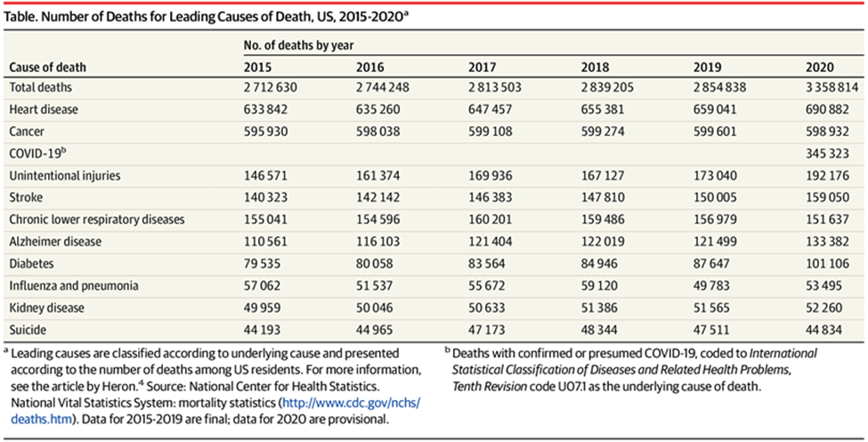
Tabular presentation
Table. Number of Deaths for Leading Causes of Death, US, 2015-2020

Slide 7
Bar graph presentation
The bar graph shows the number of leading underlying causes of death (National Vital Statistics System), United States, 2020.
In this case, the bar graph is drawn horizontally, where the independent variables are plotted along a vertical axis from the bottom up.
The values of the function are shown as shaded or colored horizontal bars of equal thickness extending toward the right, with their left ends vertically aligned.
Presenting data in this form provides a clear visual presentation that can be accessed by a large audience.
Notes:
The second form is the bar graph (figure 2) which shows the number of leading underlying causes of death (National Vital Statistics System), United States, 2020. A bar graph is a pictorial rendition of statistical data in which the independent variable can attain only certain discrete values. The dependent variable may be discrete or continuous. In this case, the bar graph is drawn horizontally, where the independent variables are plotted along a vertical axis from the bottom up. The values of the function are shown as shaded or colored horizontal bars of equal thickness extending toward the right, with their left ends vertically aligned. Presenting data in this form provides a clear visual presentation that can be accessed by a large audience.

Slide 8
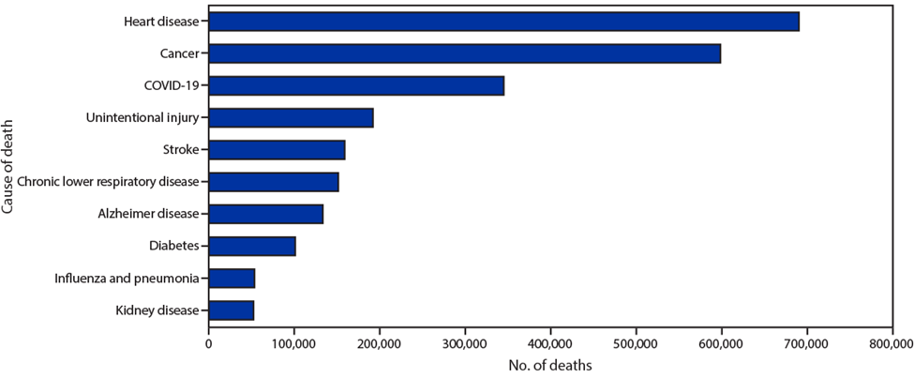
Bar graph

Slide 9
Each category of data has been presented in a frequency distribution, and one can observe the highest cause of death.
One of the limitations of this type of data presentation is that it failed to expose some key assumptions, causes, impacts, and patterns of the causes of death.
It is also very challenging, especially when estimating appropriate values of particular causes of death.
Meanwhile, it is important to present such data in tabula form than in bar graph because it can easily be converted to any other form.
Notes:
Also, each category of data has been presented in a frequency distribution, and one can observe the highest cause of death. One of the limitations of this type of data presentation is that it failed to expose some key assumptions, causes, impacts, and patterns of the causes of death, unlike in (Figure 1) which has key assumptions. It is also very challenging, especially when estimating appropriate values of particular causes of death. Meanwhile, it is important to present such data in tabula form than in bar graph because it can easily be converted to any other form.

Slide 10
Conclusion
It is significant for responsible bodies to provide mortality data yearly in every country across the world.
These data provide early indications especially to policymakers and researchers to oversee changes in mortality trends.
The data can also be used by the public health organizations in implementing policies and interventions to reduce the mortality rate that is directly or indirectly associated with the COVID-19 pandemic.
Notes:
It is significant for responsible bodies to provide mortality data yearly in every country across the world. These data provide early indications especially to policymakers and researchers to oversee changes in mortality trends and suggest actions that can be implemented to reduce the rate of mortality as well as comparing the current data with the previous one. The data can also be used by the public health organizations in implementing policies and interventions to reduce the mortality rate that is directly or indirectly associated with the COVID-19 pandemic and among persons most affected, including those who are older, male, or from disproportionately affected racial/ethnic minority groups.

Slide 11
references
Ahmad, F. B., & Anderson, R. N. (2021). The leading causes of death in the US for 2020. JAMA, 325(18), 1829-1830. Retrieved from: https://jamanetwork.com/journals/jama/fullarticle/2778234
Ahmad, F. B., Cisewski, J. A., Miniño, A., & Anderson, R. N. (2021). Provisional mortality data—united states, 2020. Morbidity and Mortality Weekly Report, 70(14), 519. Retrieved from: https://www.cdc.gov/mmwr/volumes/70/wr/mm7014e1.htm

